Slide 1



TAPOVAN TOOLS AND PROTO TECH LLP
ADD COMPANY NAME
EXCELLENCE IN ENGINEERING SOLUTIONS

Slide 2


INTRODUCTION
Tapovan Group was established in 2008 with the aim of participating in and catalyzing the modernization of the Indian automotive and non automotive components industrial sector. Tapovan Group primarily deals in supplying engineering and Manufacturing services like,
Sheet metal press Component
Precision manufacturing of sheet metal stamping
Tooling's Manufacturing
Proto type
Precision machining

Slide 3
Mission
On time Product delivery without compromising the product quality
Provide Quality products and services to our valued customer
Ensure the culture of teamwork, employee growth
Our Mission and Vision
Vision
Innovative process to be established in terms of technology to capture the market share and build /trust relationships with customer

Slide 4
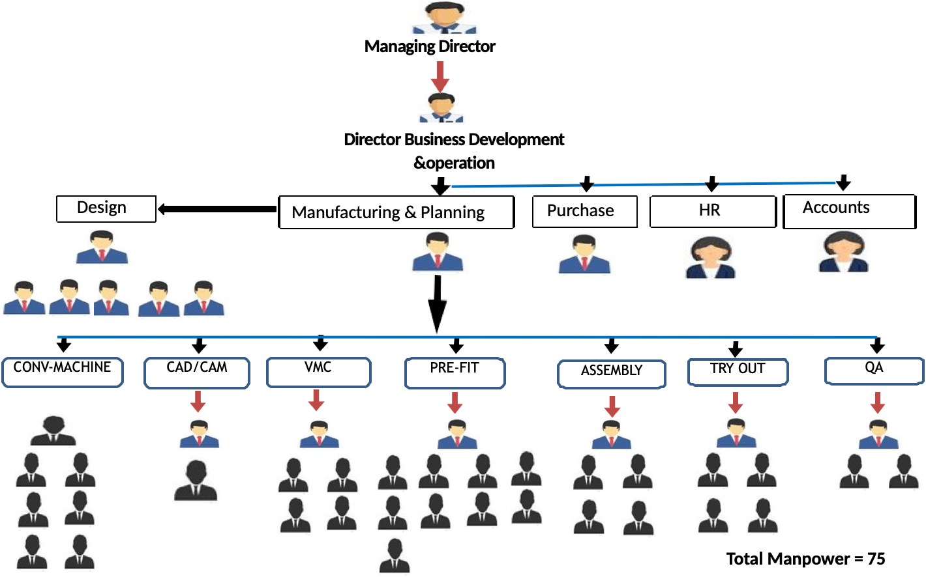
ORGANISATION
CHART

Slide 5

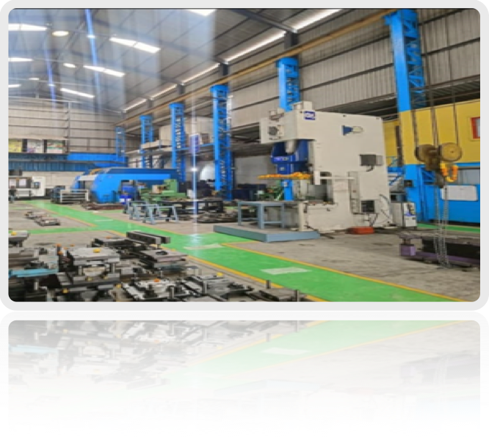
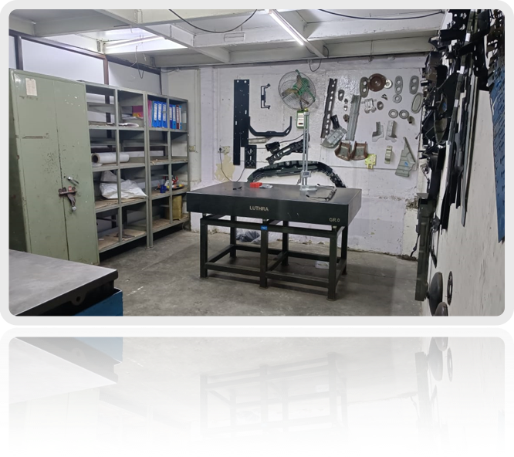
PICTURES

Slide 6
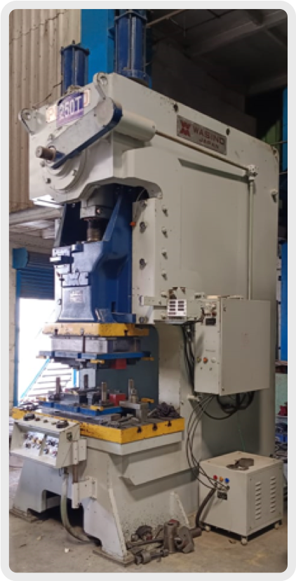
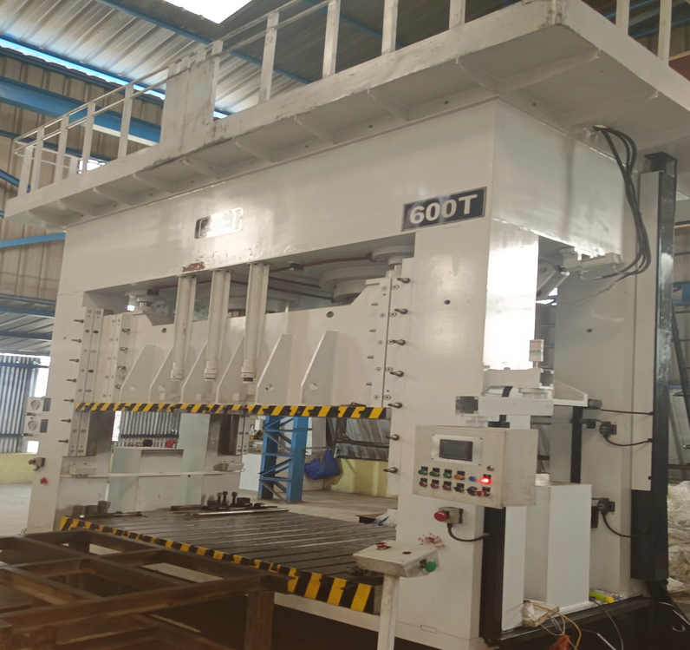
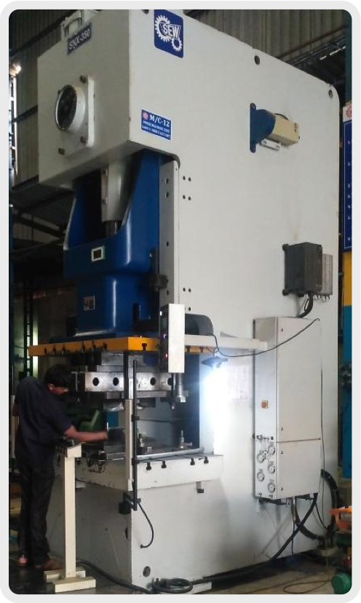
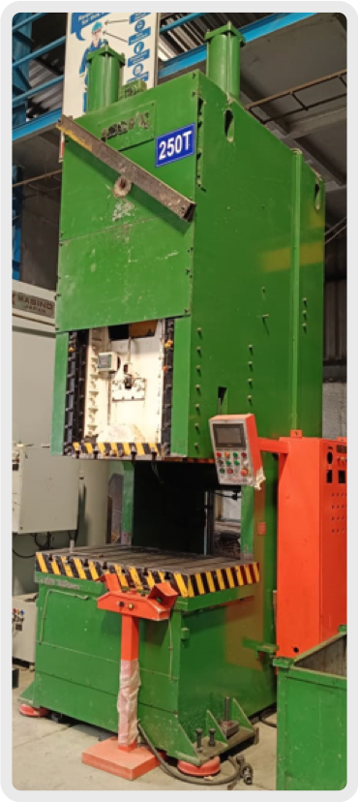
TRIAL PRESS
350 T SEW PNEUMATIC PRESS
150 T PNEUMATIC PRESS
600 T HYDRAULIC PRESS
250 T SEW PNEUMATIC PRESS
BED 2500 X 1500
MAX SHUT HEIGHT 850

Slide 7
MACHINE | MAKE / MODEL | RANGE / CAPACITY
VMC (3 Nos.) | BFW CHAKARA | 1250 X 650 X 650
VMC 5-AXIS | FOREST LINE | 8000 X 2400 X 1000
JIG BORING | WMW | 1200 X 700 X 700
HORIZONTAL BORING | UNION | DIA 100 STOCK X 1600 X 1600
SHEARING | ENERGY | 6 X 2500
Customise this table! Just right-click on any cell to see all the available table functions.
To merge, first highlight two or more cells, then click "Merge Cells" to organize your table according to your needs!

Slide 8
MACHINE | MAKE / MODEL | RANGE / CAPACITY
BENDING | ENERGY | 6 X 2500
3 D LESER CUTTING | PRIMA | 750X1500X 4000
MILLING MACHINE (2 Nos. ) | FRIDERICH | 700X640X300
SURFACE GRINDER ( 2 Nos.) | PARROT | 600X200
DRILL MACHINE (4Nos.) | PRAKASH | ½ “-2 NOS, 1 ½ “ 1 NO, 2½ 1 NO
Customise this table! Just right-click on any cell to see all the available table functions.
To merge, first highlight two or more cells, then click "Merge Cells" to organize your table according to your needs!

Slide 9
MACHINE | MAKE / MODEL | RANGE / CAPACITY
BENCH GRINDER | ELMECH | 7 INCH
LATHE MACHINE ( 2 Nos.) | RAVI | 7 ½ FT.
3D LASER | PRIMA | 4000 X 1500 X 760 (4KW)

Slide 10
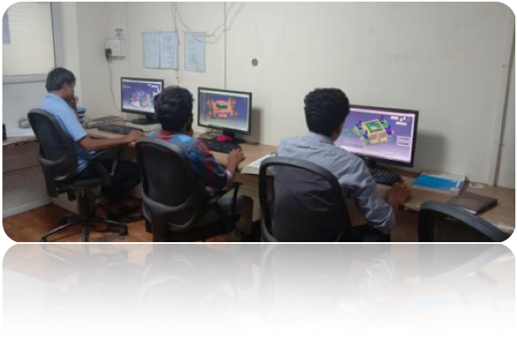
Design Department
The emerging youth team in design ,having good strength
1 Design Head
1 Team Leader
6 no’s Designer
1 Draftsman
Software used
Catia
Unigraphics
AutoCAD
Auto form

Slide 11
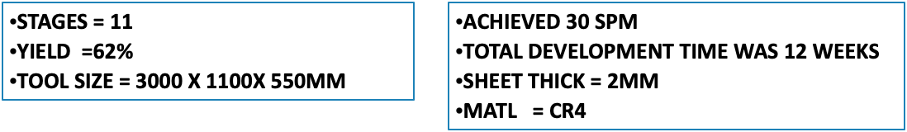
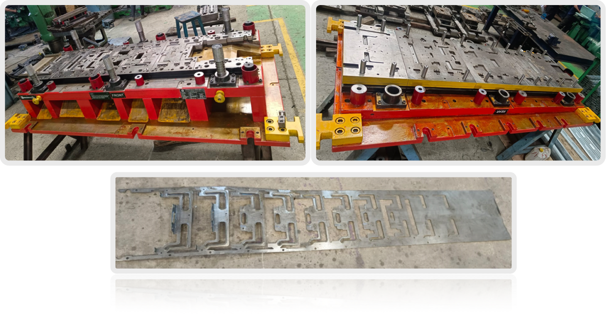
IN HOUSE MANUFACTURED PRESS TOOL

Slide 12

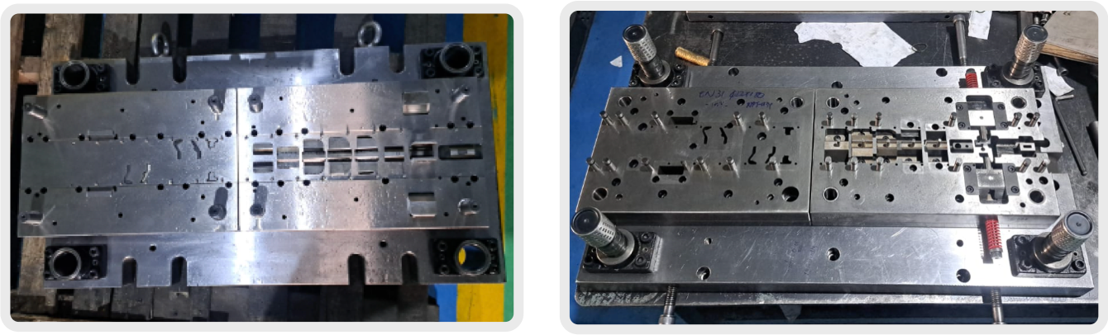
IN HOUSE MANUFACTURED PRESS TOOL

Slide 13
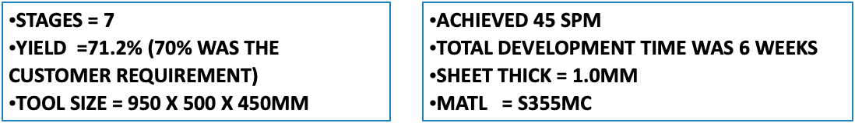
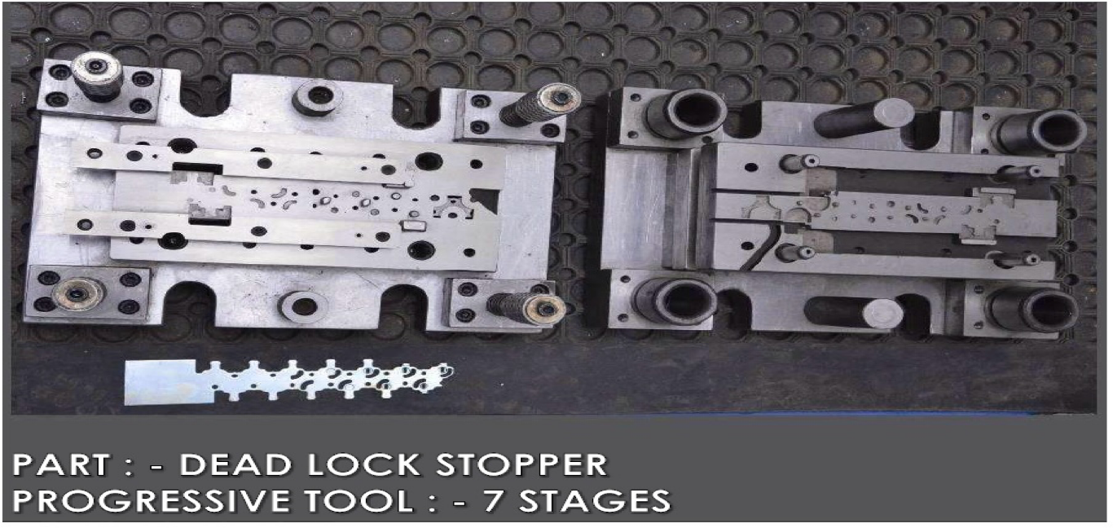
IN HOUSE MANUFACTURED PRESS TOOL

Slide 14
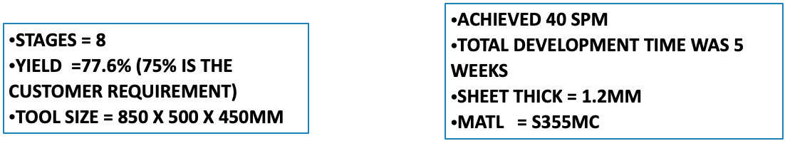
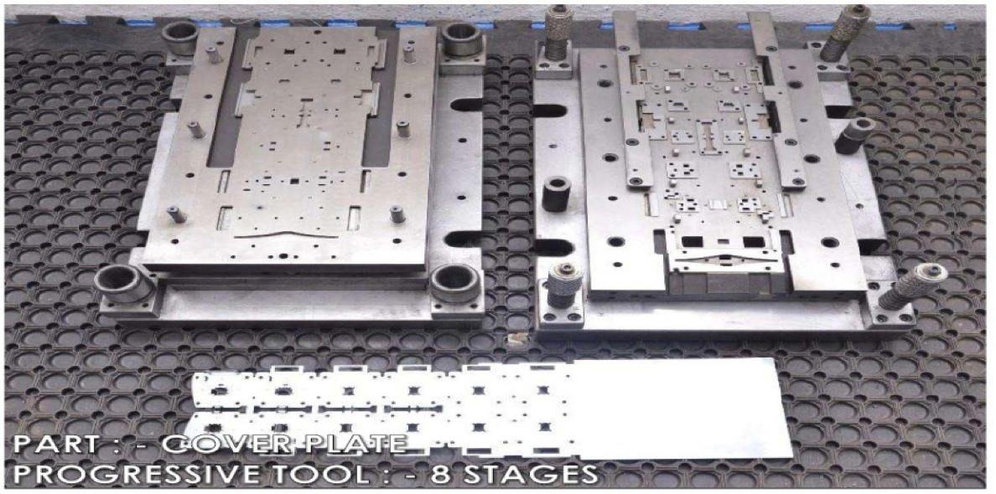
IN HOUSE MANUFACTURED PRESS TOOL

Slide 15
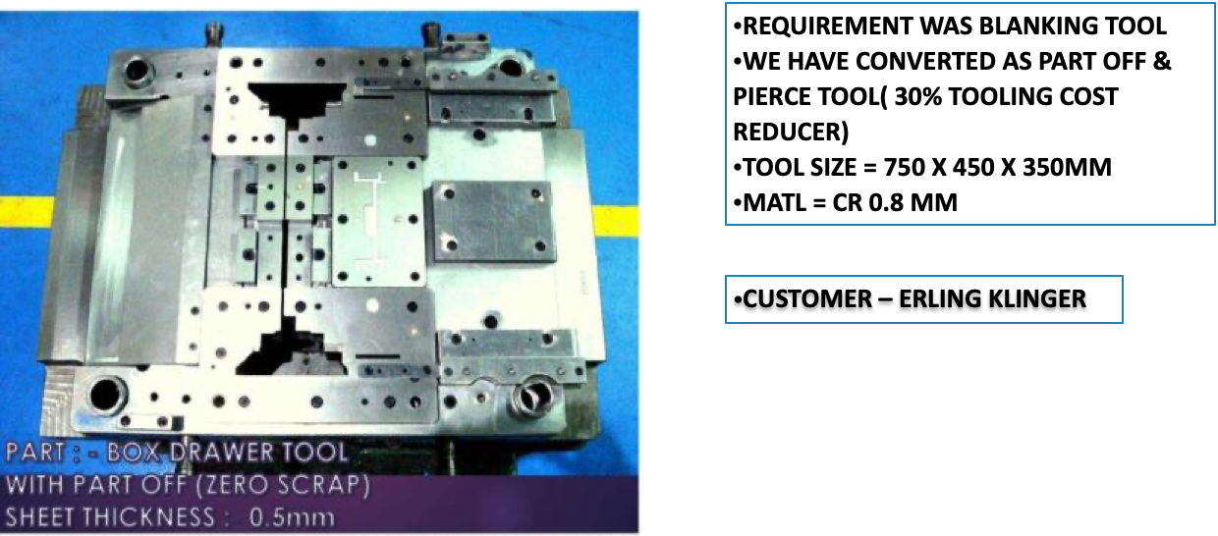
IN HOUSE MANUFACTURED PRESS TOOL

Slide 16

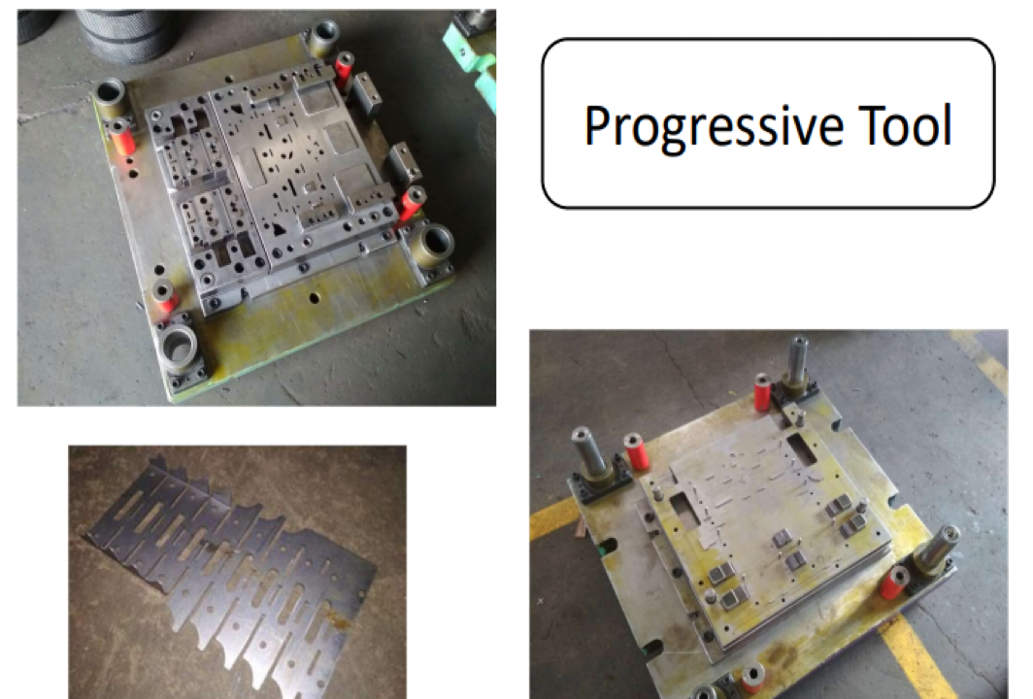

Slide 17
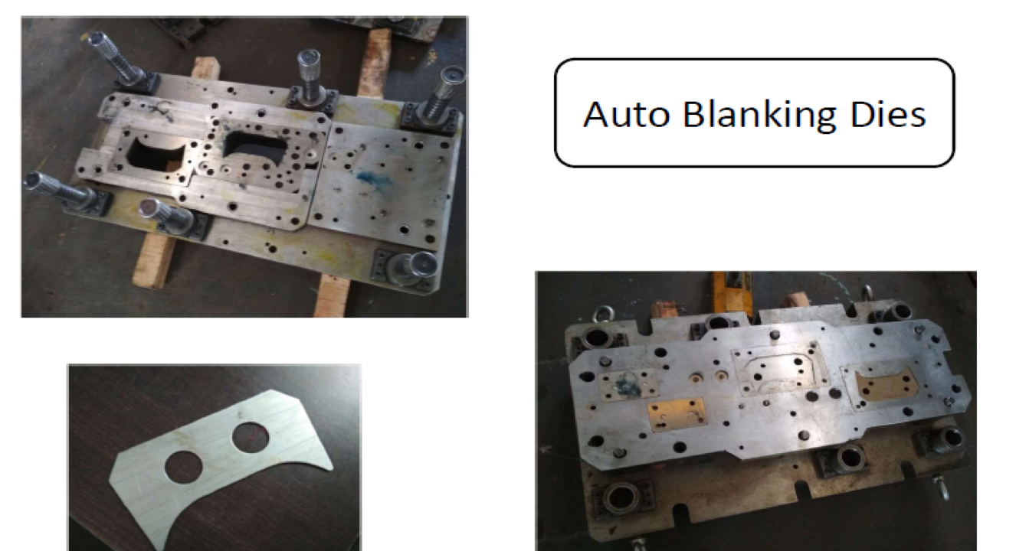

Slide 18
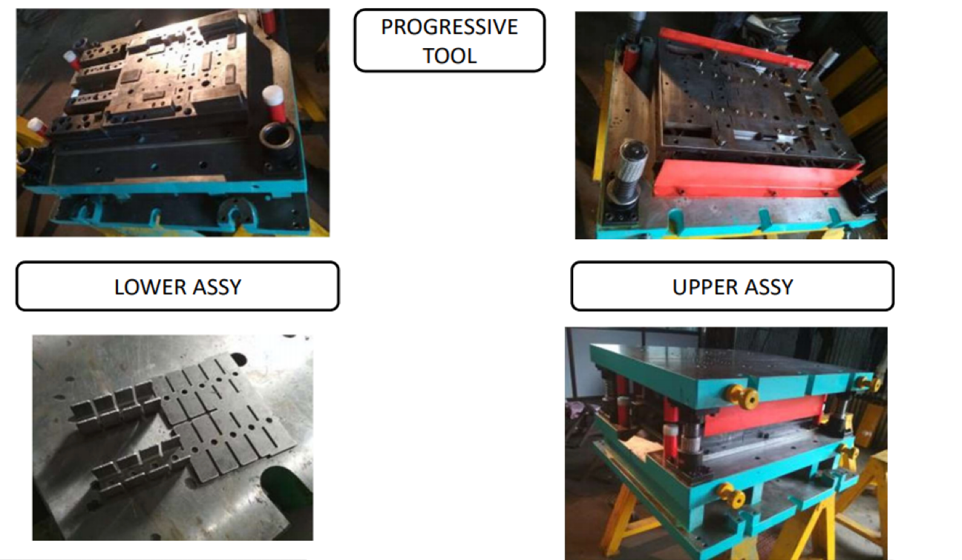

Slide 19
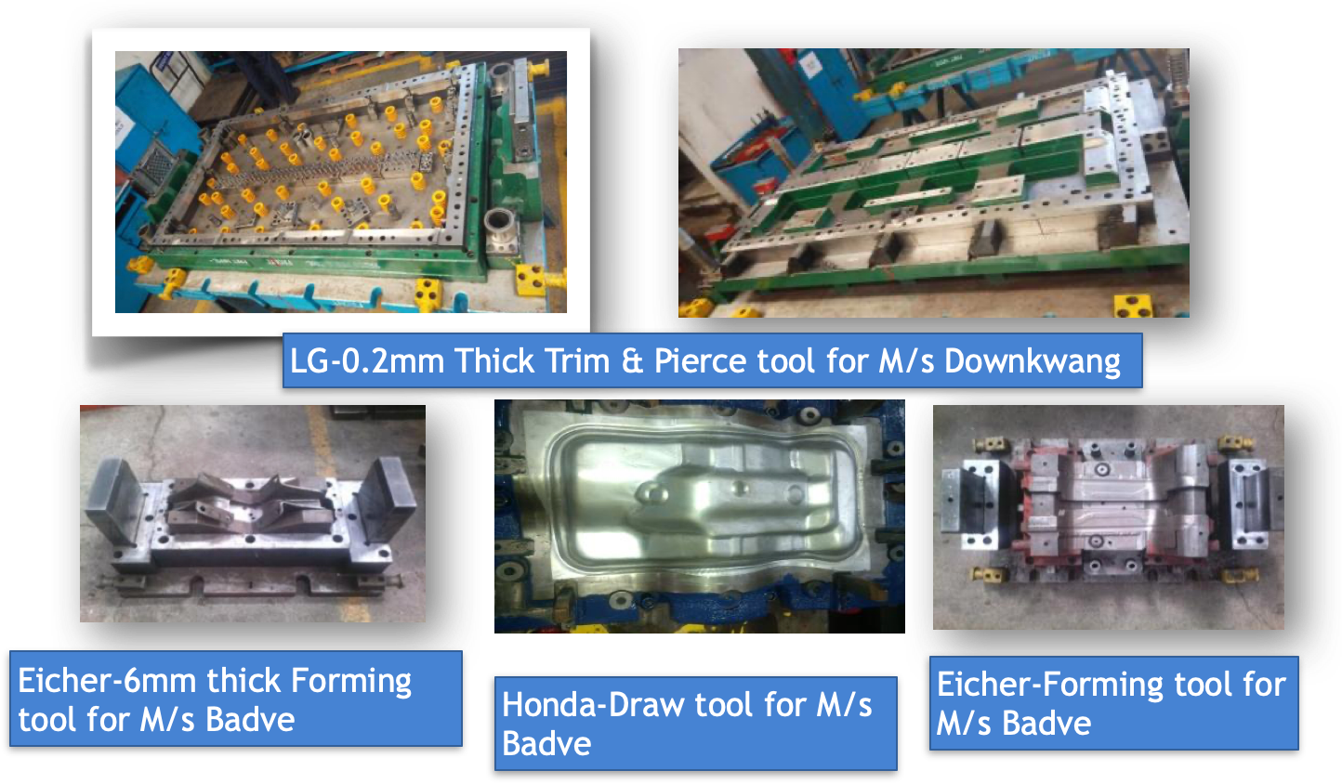

Slide 20
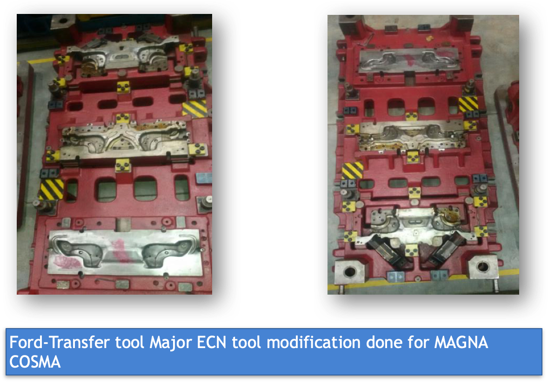

Slide 21
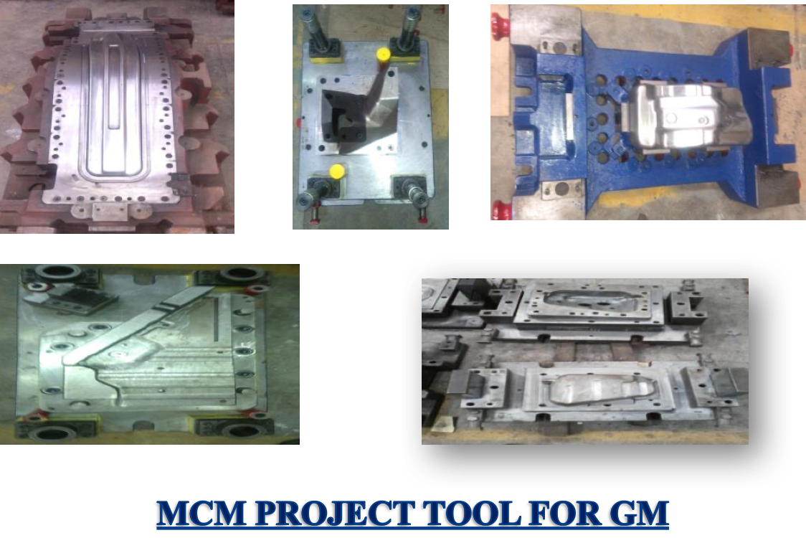

Slide 22
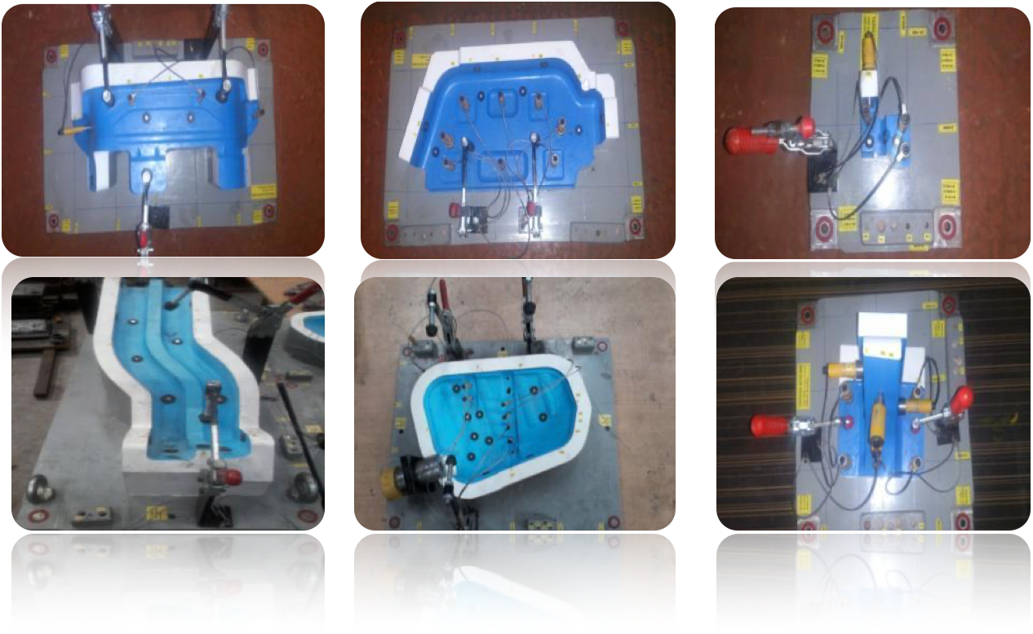
For VOLVO-EICHER and HONDA

Slide 23
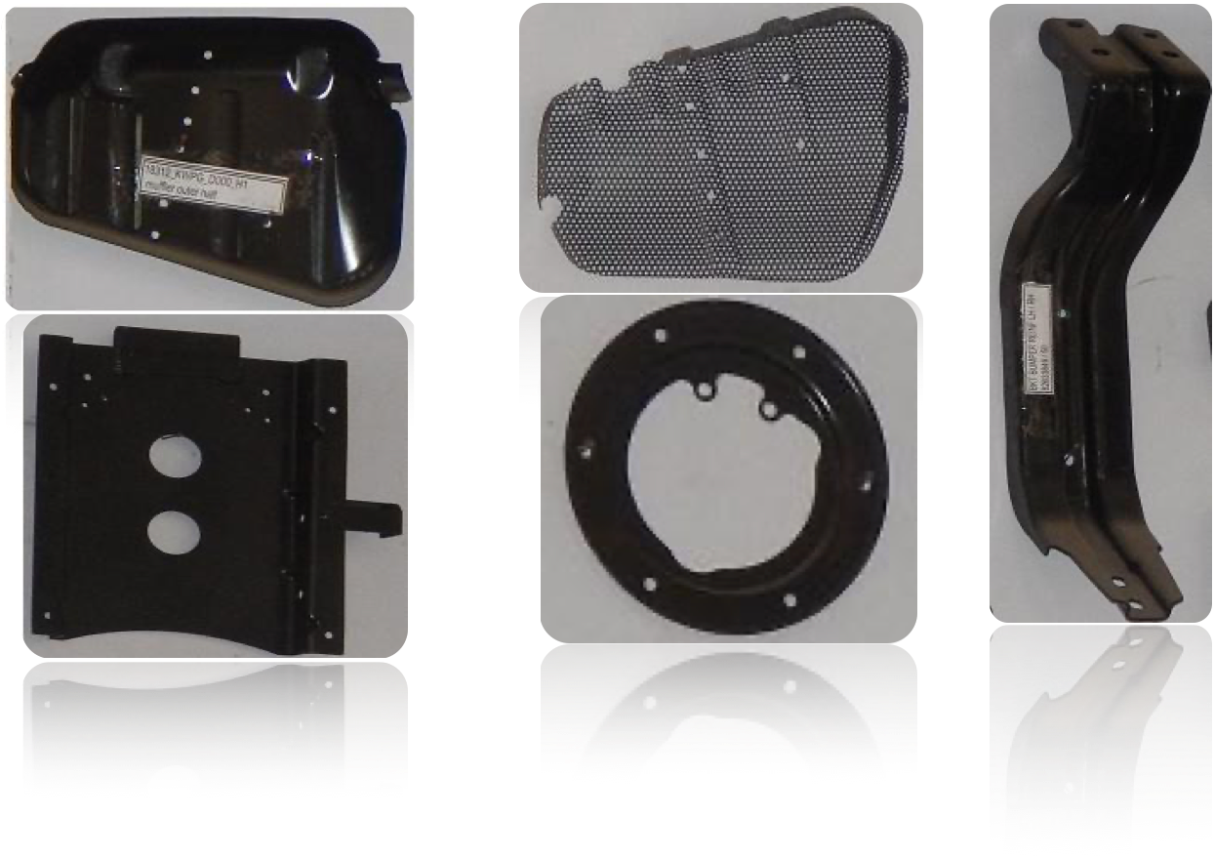
IN HOUSE DEVELOPED PARTS

Slide 24
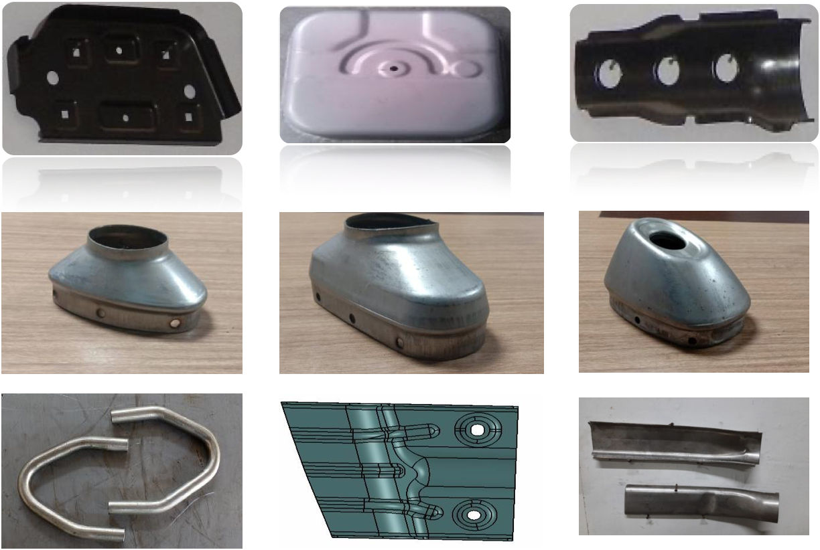
KTM DUKE SILENCER END CAPS

Slide 25
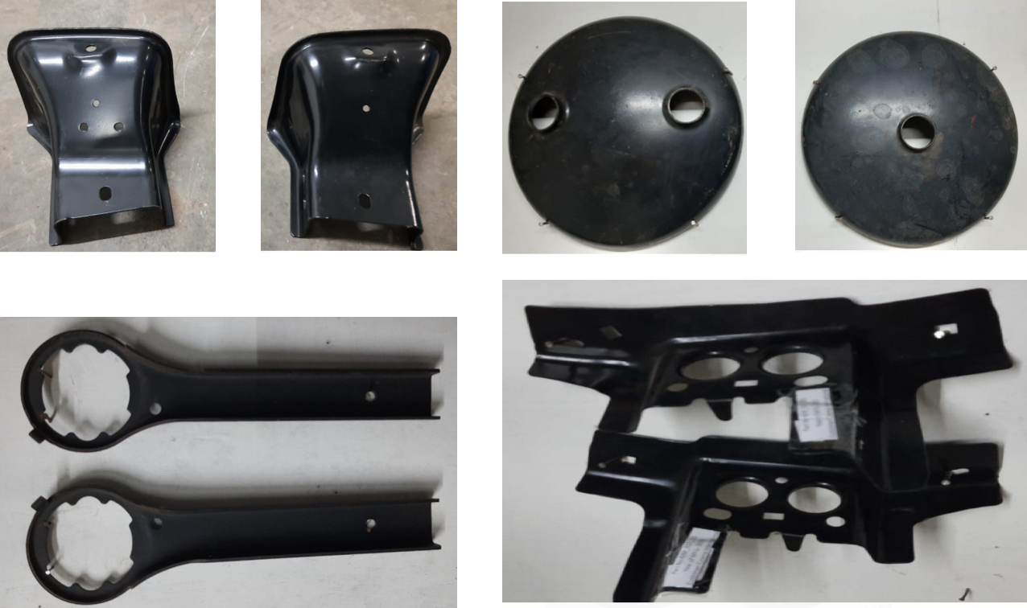
OTHER PARTS

Slide 26
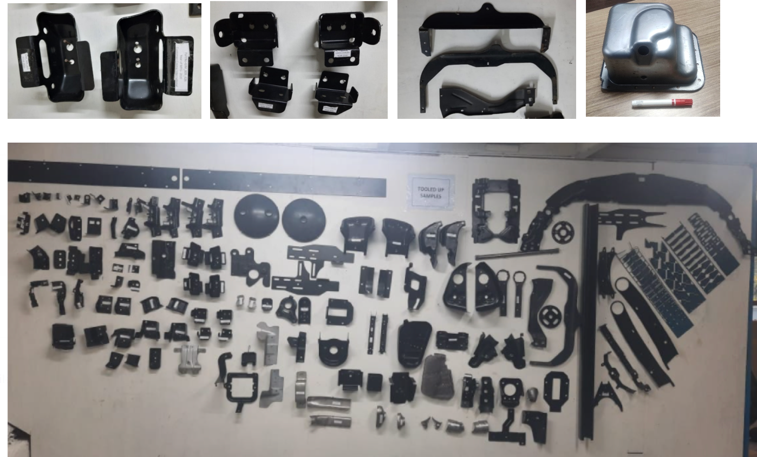

Slide 27


Our CUSTOMERS

Slide 28


Connect with us.
Email
gopal.divakaran@tapovantools.in
abhishek.mankare@tapovantools.in
npd@tapovantools.in
Address
S block W220 MIDC BHOSARI PUNE 411026
Call us
9552266777
9890338400

